Slide 1
Querying and mining of time series data: experimental comparison of representations and distance measures
报告人：Jorfun

Slide 2
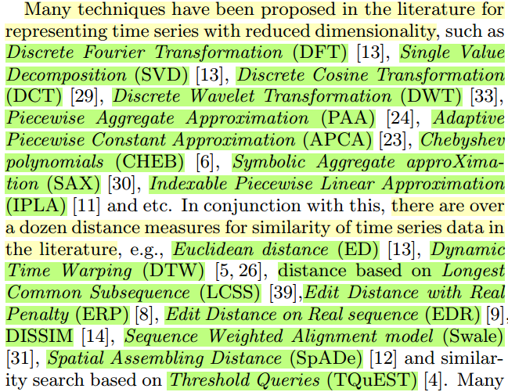
INTRODUCTION
Two key aspects for achieving effectiveness and efficiency when managing time series data are representation methods and similarity measures.

Slide 3
INTRODUCTION
However, with the multitude of competitive techniques, we believe that there is a strong need to compare what might have been omitted in the comparisons.
Every newly introduced representation method or distance measure has claimed a particular superiority. However, it has been demonstrated that some empirical evaluations have been inadequate [25] and, worse yet, some of the claims are even contradictory.
The risk is that this may not only confuse newcomers and practitioners of the field, but also cause a waste of time and research efforts due to assumptions based on incomplete or incorrect claims.

Slide 4
INTRODUCTION
We have re-implemented 8 different representation methods for time series, and compared their pruning power over various time series data sets. We have re-implemented 9 different similarity measures and their variants, and compared their effectiveness using 38 real world data sets from highly diverse application domains.

Slide 5
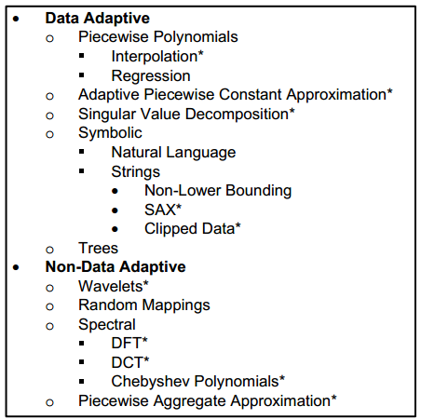
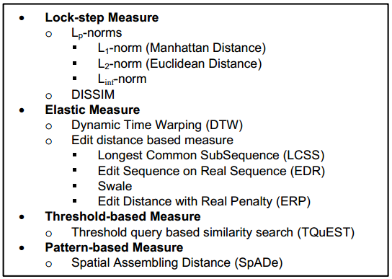
PRELIMINARIES

Slide 6
COMPARISON OF TIME SERIES REPRESENTATIONS
Compare all the major time series representations, including SAX, DFT, DWT, DCT, PAA, CHEB, APCA and IPLA.
What metric should be used for comparison?
We believe that using the tightness of lower bounds (TLB) is a very meaningful measure [24], and this also appears to be the current consensus in the literature [6, 8, 11, 21–23, 26, 35, 40]. We note that all the representation methods studied in this paper allow lower bounding.
implementation-free, accurate prediction of indexing performance

Slide 7
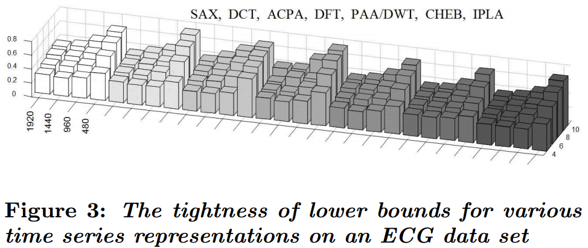
COMPARISON OF TIME SERIES REPRESENTATIONS
The result of this experiment shows that there is very little difference between representations, in spite of claims to the contrary in the literature.
Incorrect claims caused by implementation bias and data bias.

Slide 8
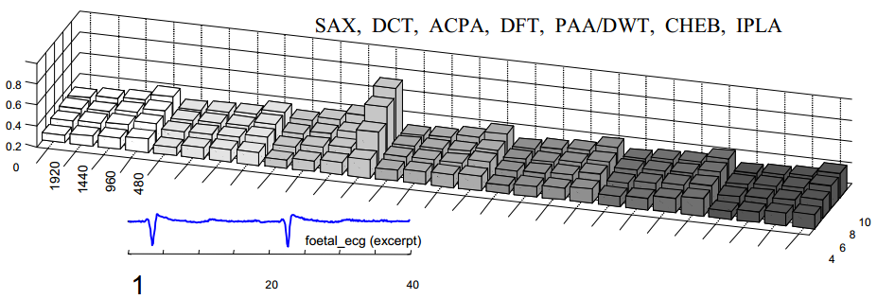
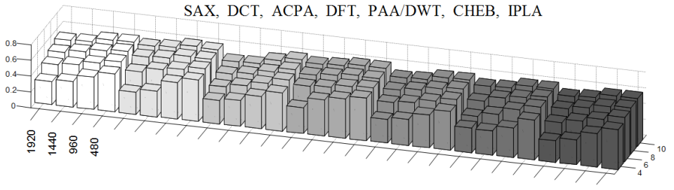
COMPARISON OF TIME SERIES REPRESENTATIONS

Slide 9
COMPARISON OF TIME SERIES SIMILARITY MEASURES
The Effect of Data Set Size on Accuracy and Speed
As data sets get larger, the amortized speed of elastic measures approaches that of lock-step measures, however the accuracy/precision of lock-step measures approaches that of the elastic measures.
Our observation suggests that even if the method is faster than DTW, the speed difference will decrease for larger data sets. Furthermore, for large data sets, the differences in accuracy/precision will also diminish or disappear.

Slide 10
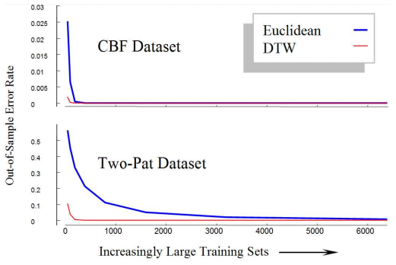
COMPARISON OF TIME SERIES SIMILARITY MEASURES
The Effect of Data Set Size on Accuracy and Speed

Slide 11
COMPARISON OF TIME SERIES SIMILARITY MEASURES
The Effect of Data Set Size on Accuracy and Speed
This experiment can also be used to demonstrate our claim that amortized speed of a (lower-boundable) elastic method approaches that of Euclidean distance.
Euclidean distance: O(n)
DTW: O(nw)
Similarity search / 1NN classification, DTW with LB_Keogh: O((P · n) + (1 − P) · nw)
To summarize, many of the claims over who has the fastest or most accurate distance measure have been biased by the lack of tests on very (or even slightly) large data sets.

Slide 12
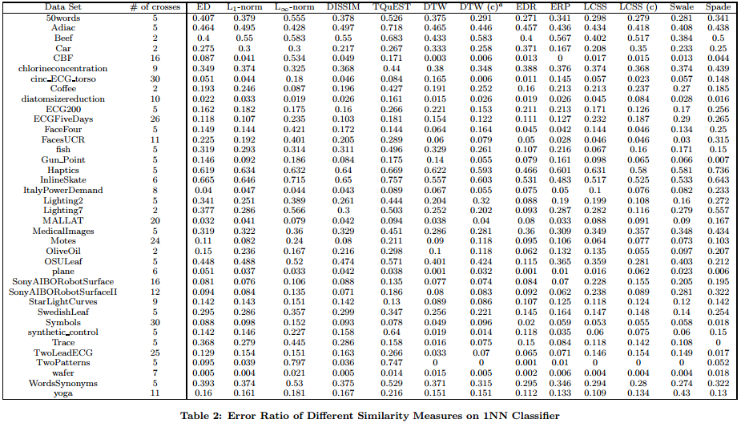
COMPARISON OF TIME SERIES SIMILARITY MEASURES
Accuracy of Similarity Measures

Slide 13
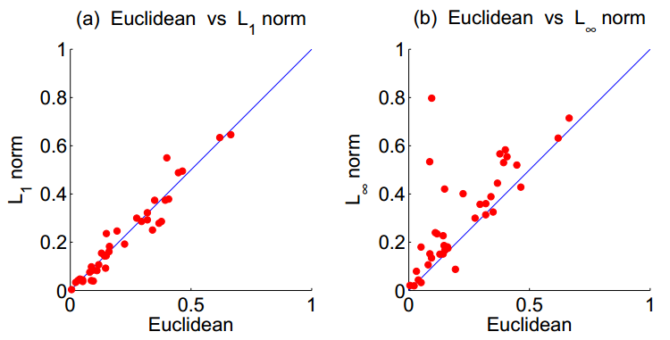
COMPARISON OF TIME SERIES SIMILARITY MEASURES
Accuracy of Similarity Measures
To provide a more intuitive illustration of the performance of the similarity measures compared in Table 2, we now use scatter plots to conduct pair-wise comparisons.

Slide 14
COMPARISON OF TIME SERIES SIMILARITY MEASURES
Accuracy of Similarity Measures
In summary, we found through experiments that there is no clear evidence that there exists one similarity measure that is superior to others in the literature, in terms of accuracy. While some similarity measures are more effective on certain data sets, they are usually inferior on some others data sets. This does not mean that the time series community should settle with the existing similarity measures, quite the contrary. However, we believe that more caution need to be exercised to avoid making the kind of mistakes we illustrate in the Appendix.

Slide 15
Conclusion
Based on the experimental results we obtained, we make the following conclusions.
The tightness of lower bounding, thus the pruning power, thus the indexing effectiveness of the different representation methods for time series data have, for the most part, very little difference on various data sets.
For time series classification, as the size of the training set increases, the accuracy of elastic measures converge with that of Euclidean distance. However, on small data sets, elastic measures, e.g., DTW, LCSS, EDR and ERP etc. can be significantly more accurate than Euclidean distance and other lock-step measures, e.g., L∞-norm, DISSIM.
Constraining the warping window size for elastic measures, such as DTW and LCSS, can reduce the computation cost and enable effective lower-bounding, while yielding the same or even better accuracy.
The accuracy of edit distance based similarity measures, such as LCSS, EDR and ERP are very close to that of DTW, a 40 year old technique. In our experiments, only EDR is potentially slightly better than DTW.

Slide 16
Conclusion
Based on the experimental results we obtained, we make the following conclusions.
The accuracy of several novel types of similarity measures, such as TQuEST and SpADe, are on general inferior to elastic measures.
If a similarity measure is not accurate enough for the task, getting more training data really helps.
If getting more data is not possible, then trying the other measures might help, however, extreme care must be taken to avoid overfitting.
Based on the experiments conduced in this paper and all the reproducible fair experiments in the literature, there is no evidence of any distance measure that is systematically better than DTW in general. Furthermore, there is at best very scant evidence that there is any distance measure that is systematically better than DTW in on particular problems (say, just ECG data, or just noisy data).

Slide 17
感谢聆听

